Slide 1

The ROVER (TRAVEL AND TOURISM)
TEAM MEMBERS :
RATNAVALLI, AVASARALA (2)
SAI NAGARJUNA, KOLLA (12)
HARISH CHANDRA, JYOSHI (9)
SINDHUJA, THOUTULA (43)

Slide 2
FEATURES OF ROVER :
The idea is to develop a web and mobile application for a particular tourist attraction.
Using Augmented Reality to know the historical and the cultural information of a monument or a place, also to get the instant text translation of any text to their native languages and obtain the weather Forecast even before reaching the destination.
To acquire the shortest distance suggestions, transportation facilities available, estimated time of reaching and the nearby restaurants and the accommodations along their way to destination.

Slide 3
INCREMENT 1 OUTPUT :
Developed User Interface using REST Services like
Google Maps API
OpenWeatherMap API.
Knowledge Graph Search API.
Deployed the features in Android device.

Slide 4
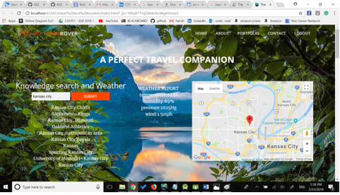
Screenshots of increment 1

Slide 5
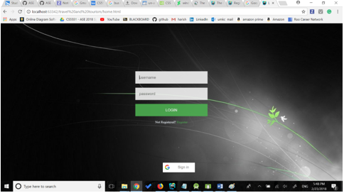
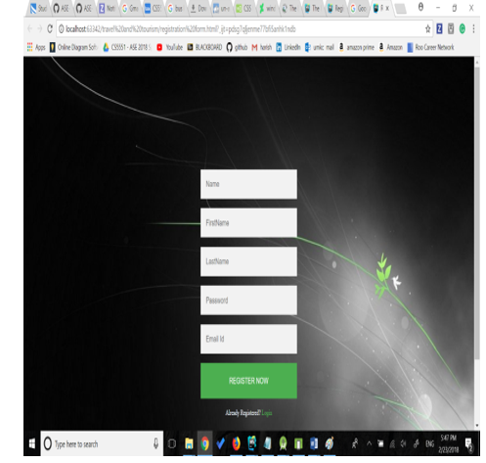

Slide 6
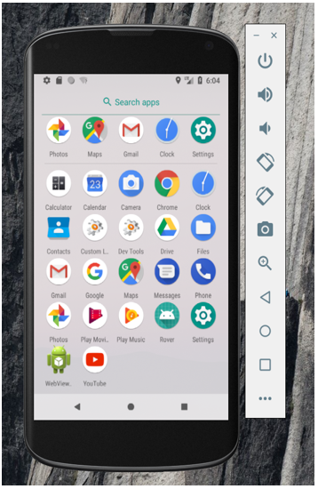
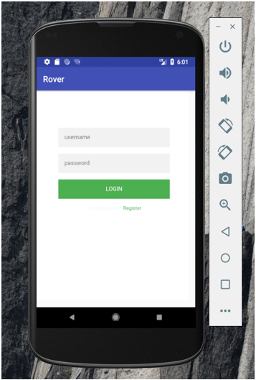
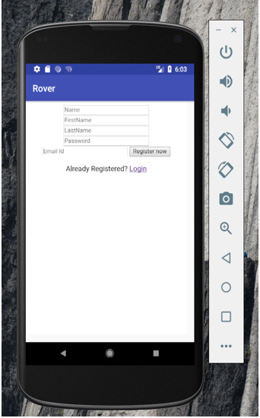
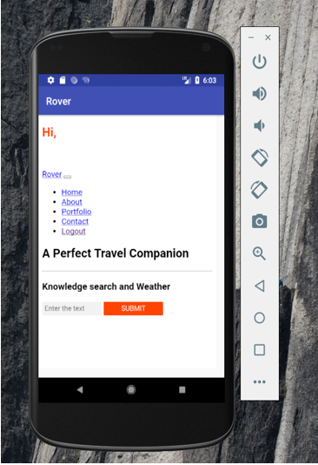

Slide 7
INCREMENT 2 GOALS :
To add more features to the app using APIs like Geo Location, Clarifai, IBM Conversion APIs.
We will try to implement AR on text translation.
Further more improvement on the UI features.

Slide 8


